Slide 1
BIRD STRIKE Analysis
RAKSHITH G
7th February, 2024

Slide 2
Introduction
A bird strike is strictly defined as a collision between a bird and an aircraft which is in flight or on a take-off or landing roll. Bird Strike is common and can be a significant threat to aircraft safety. For smaller aircraft, significant damage may be caused to the aircraft structure and all aircrafts are vulnerable to the loss of thrust which can follow the ingestion of birds into engine air intakes.

Slide 3
DATASET INFORMATION
Dataset consists of data collected on Bird Strikes by FAA between the years 2000 to 2011.
Aircraft Type, Make/Model, Size, Number of Engines, and Airline Operator
Date, Airport and State which the flight took off from
Weather Conditions, and Altitude at which the bird strike occurred
Number, Size and Species of the type of wildlife that struck
Effect of Bird Strikes & Impact on Flight
Damage and Cost incurred and Number of People injured
Whether or not the pilot was warned of the birds or wildlife
After cleaning the data and removing null entries, there are a little over 25000 records of bird strikes.

Slide 4
KEY PERFORMANCE INDICATORS
Average number of bird strikes per year
Bird Strikes that incurred damage to the airplane
Cost Incurred due to Bird Strikes
Average Altitude of the airplanes in at the time of strike
Total people injured due to Bird Strikes

Slide 5
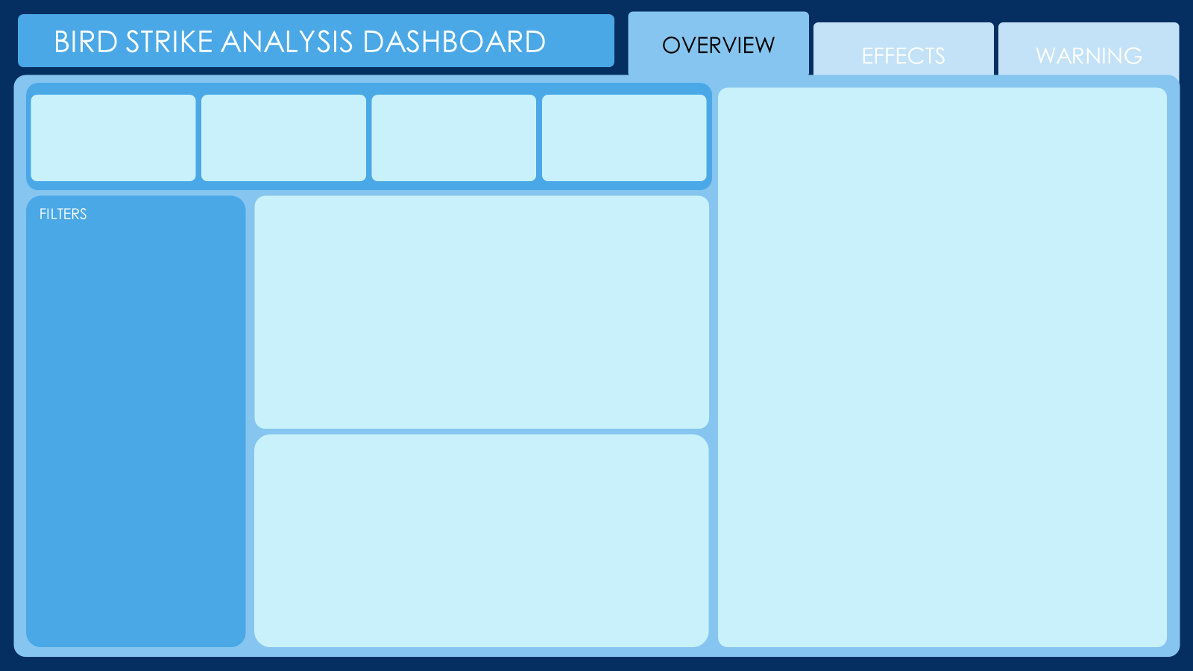
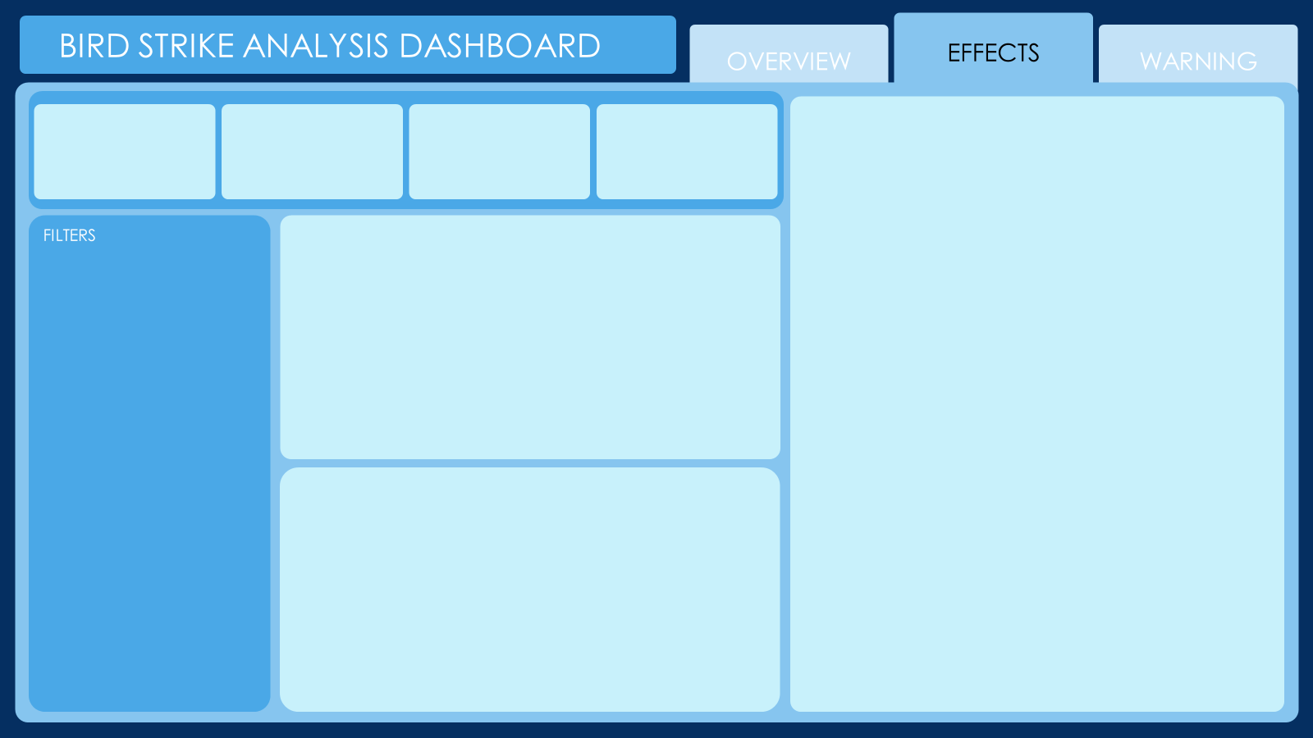
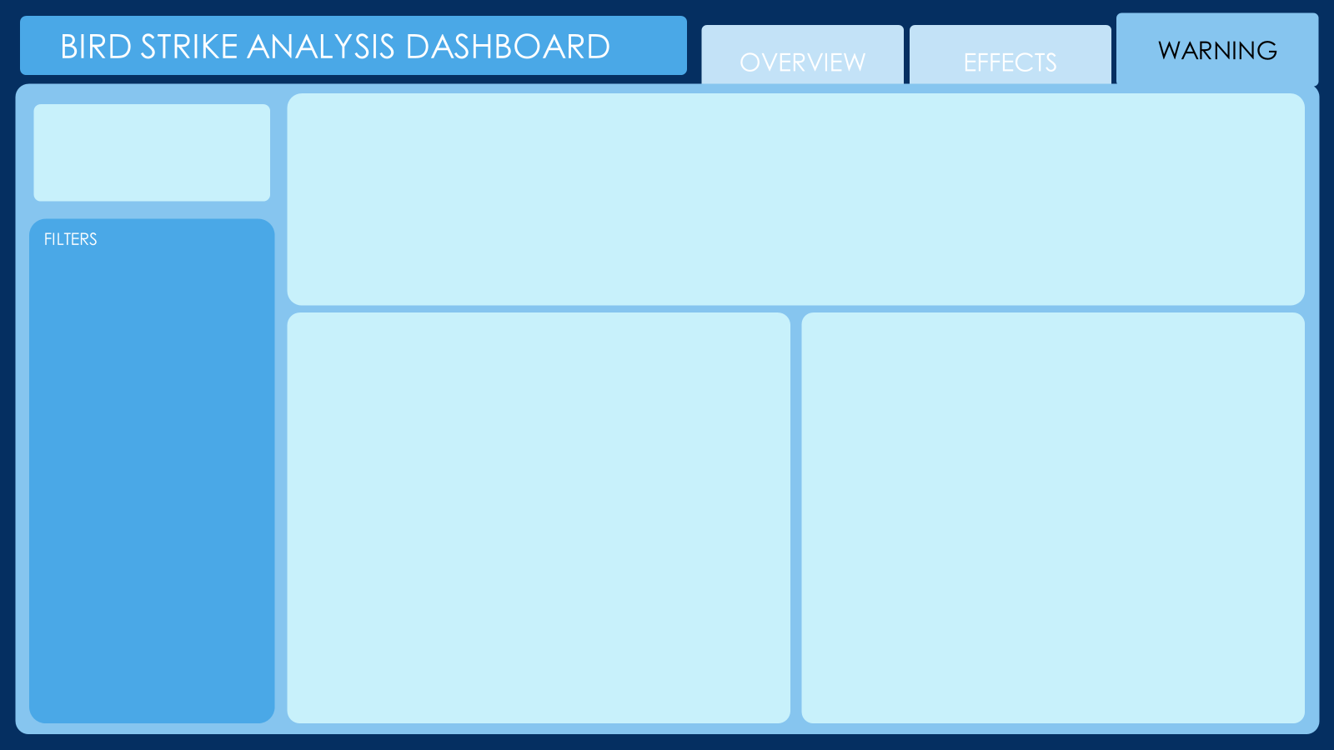
Mock–up Dashboard

Slide 6
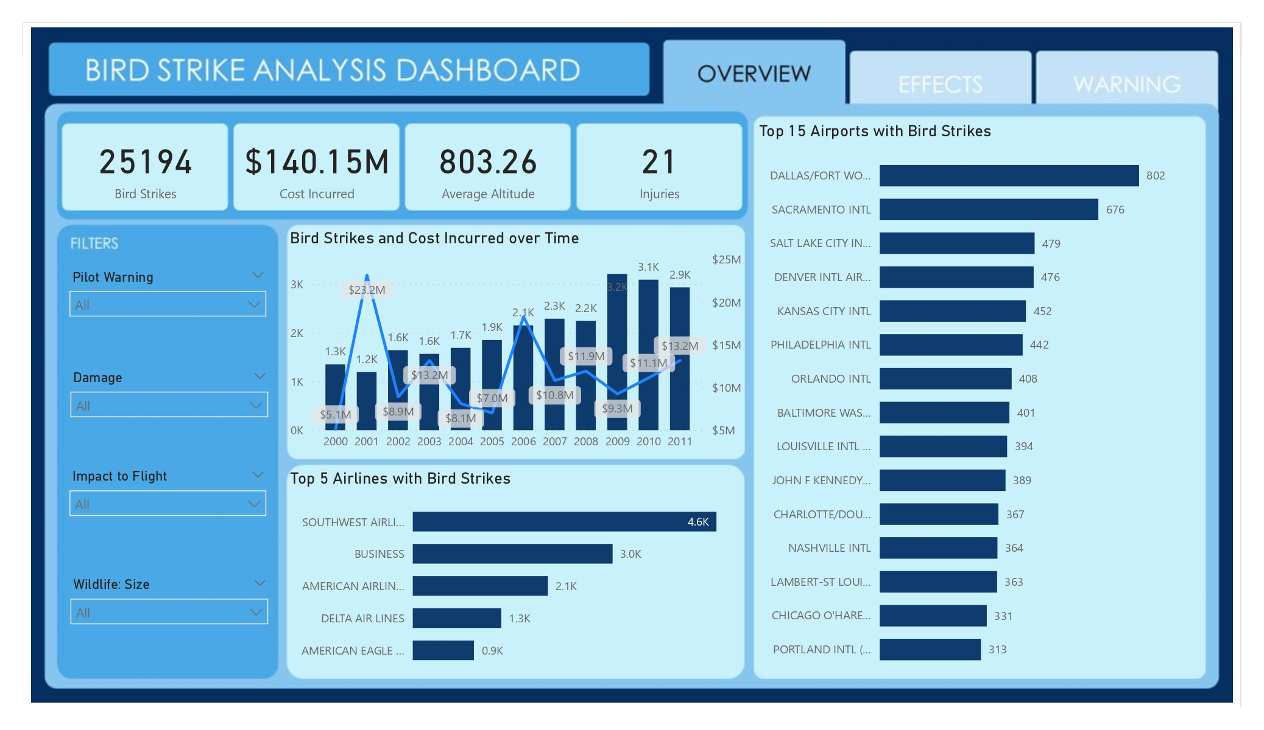
DASHBOARD

Slide 7
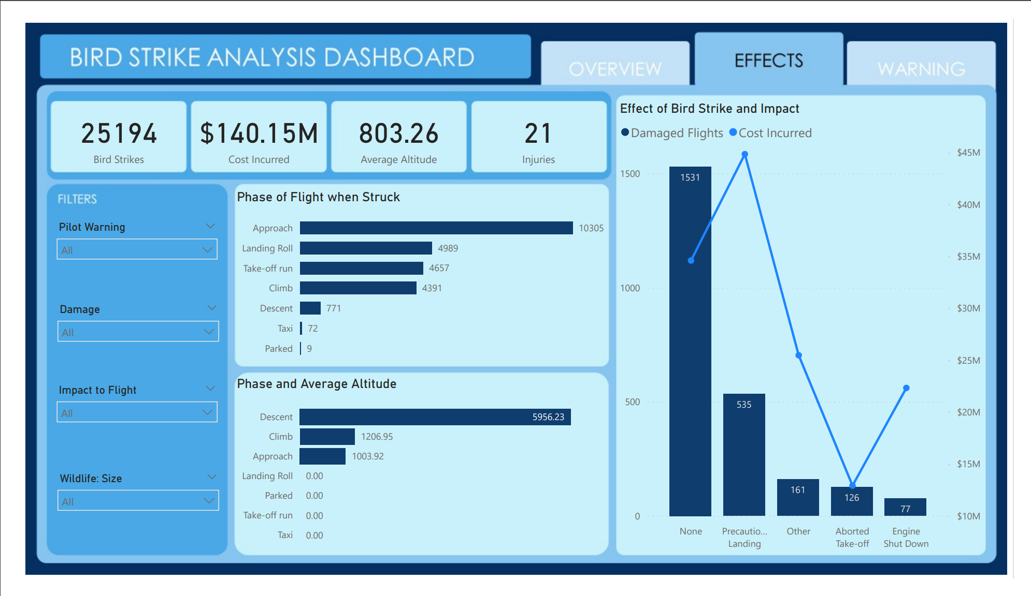
DASHBOARD

Slide 8
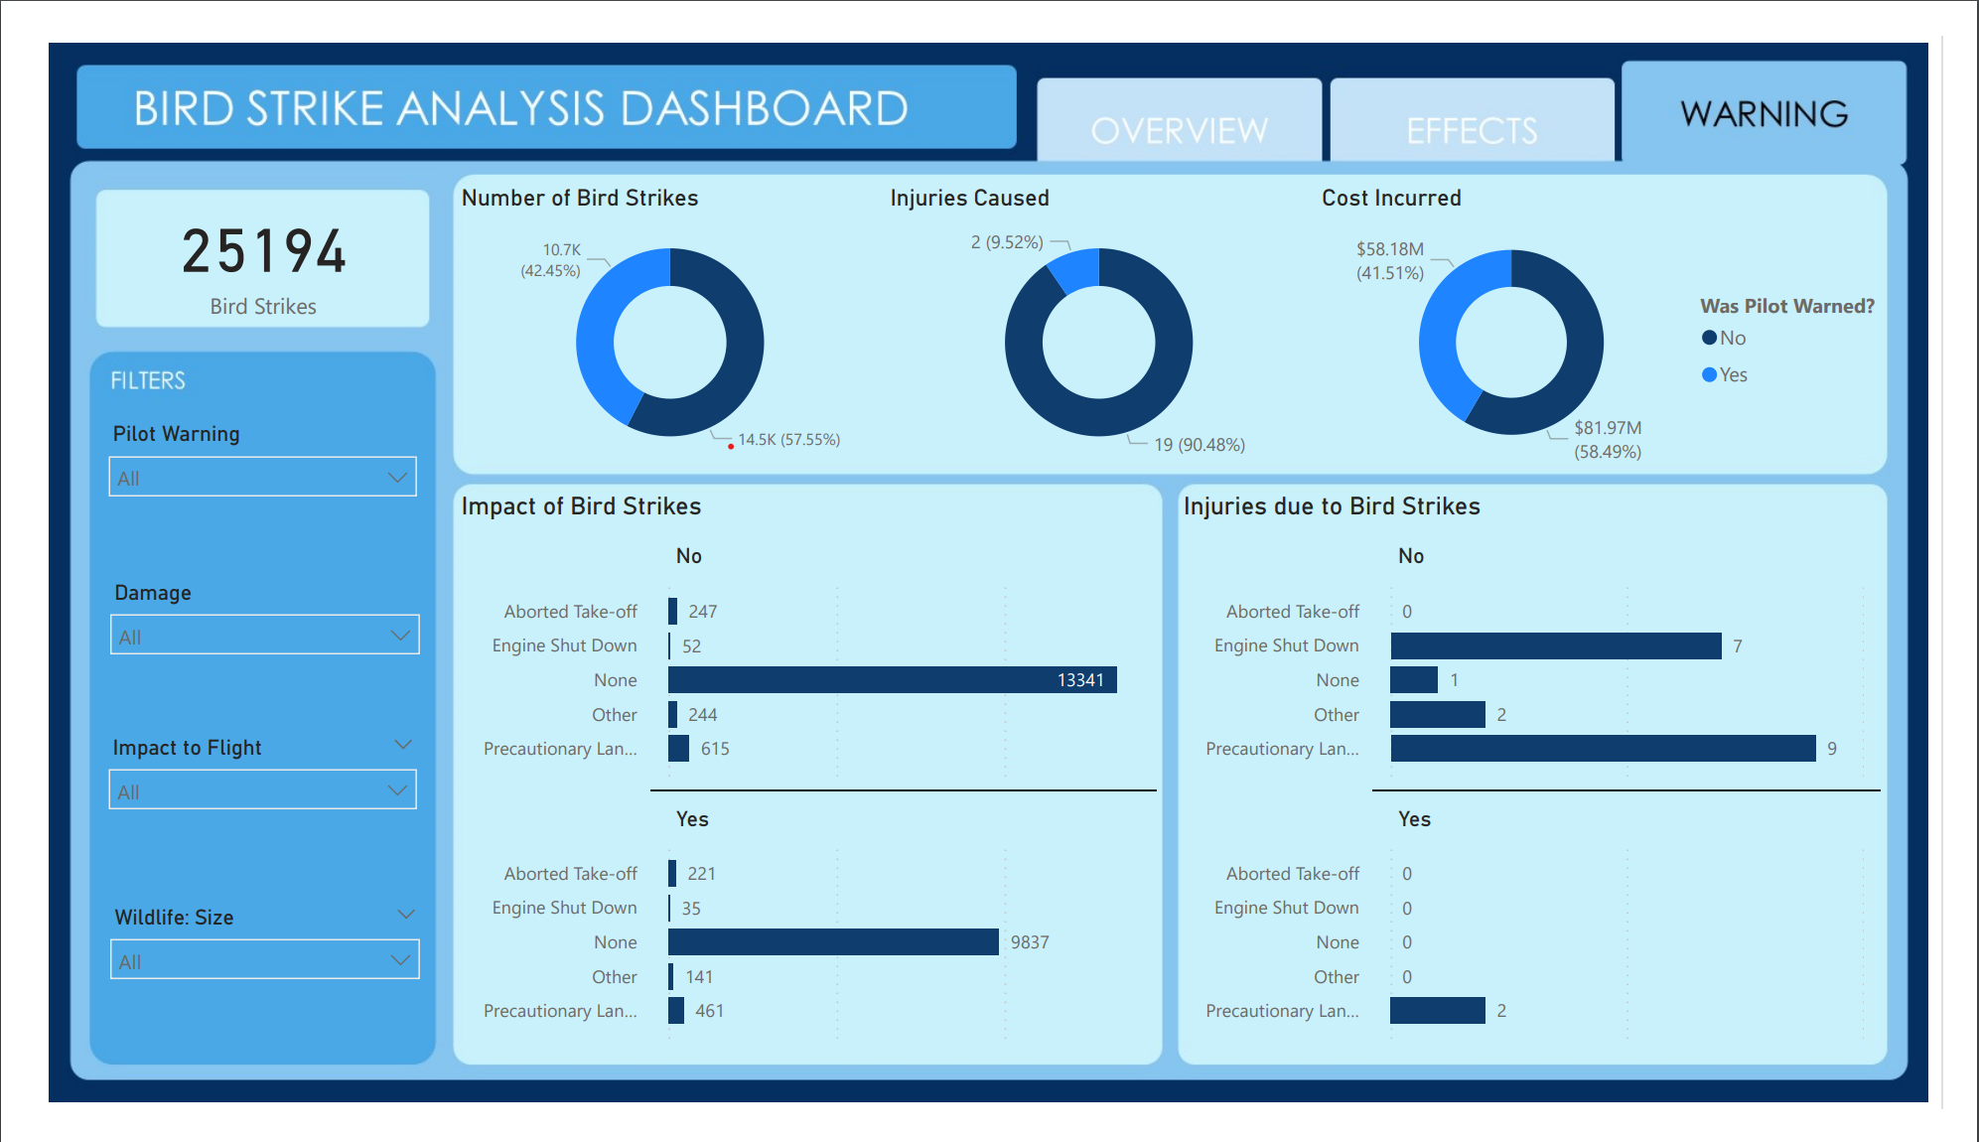
DASHBOARD

Slide 9
KEY INSIGHTS
Most bird strike have occurred during the approach phase of flight, or at an altitude of 0-250 ft. Bird strikes may occur during any phase of flight, but are more likely during the take-off, initial climb, approach and landing phases due to the greater numbers of birds in flight at lower levels.
In the 2430 bird strikes that caused damage to the flight, there was no major impact to over 1500. Over 500 flights had to land as precaution, and 126 had to abort take-off. There is a higher cost incurred when the flight makes a precautionary landing or in the case of engine shut-down.
In 57.5% of the records, the pilot was not warned of the bird strikes, causing 19 injuries and incurring a total cost of $81.97 million. In records of the pilots being warned, only 2 injuries and a total cost of $58.18 million were recorded. There is a significant difference in injuries and cost incurred when the pilot is warned ahead.
9

Slide 10
Thank you

